Slide 1


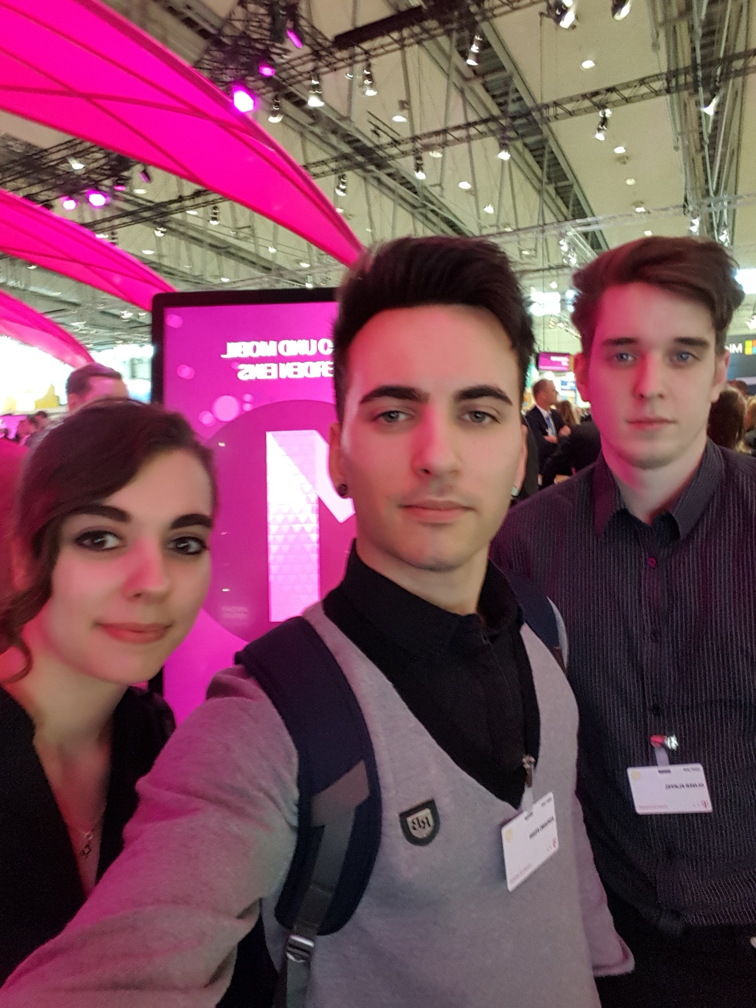
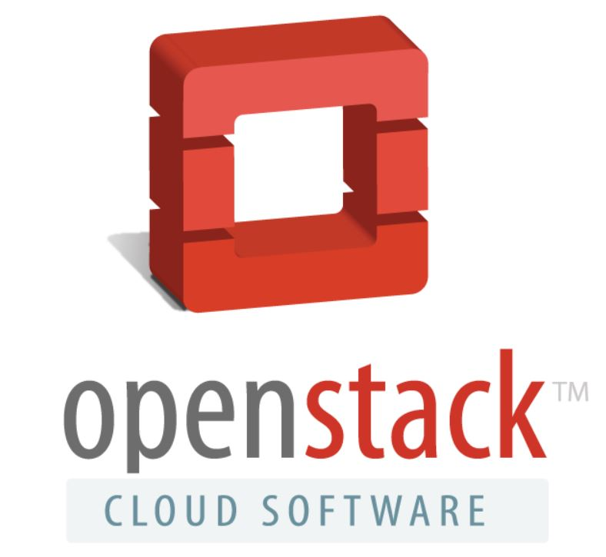
„CLOUD KINDERGARTEN“
Apprentices starting with

Slide 2


Agenda
1 | Introduction
 | 1.1 Workflow / Experiences
2 | TelekomCLOUD + OpenStack
 | 2.1 Refcard Overview
 | 2.2 Our Deployment
3 | Q & A

Slide 3
1. Introduction

Slide 4
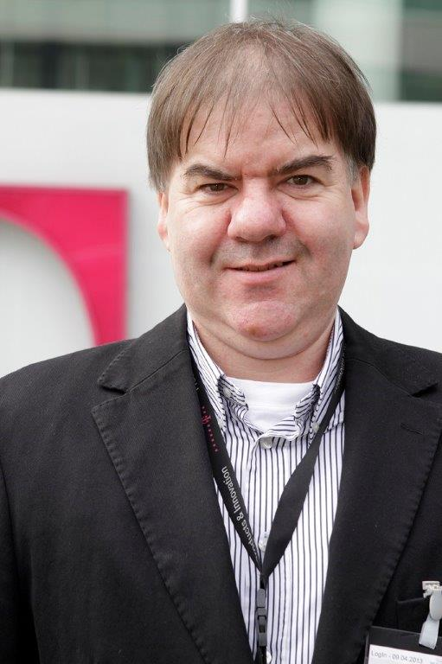
1. Introduction – Frank Klöker
Person
Education
Today
Name Frank Klöker
From Berlin
27 years of experience in Operations
Vocation Applicationmanagement for Cloud hosting platform personal point of contact for Apprentices
10 years Examiner on Chamber of Commerce and Industry
Company Deutsche Telekom AG
Business Unit Business Applications & Cloud Services
Introduction
TelekomCLOUD + OpenStack
Q & A

Slide 5
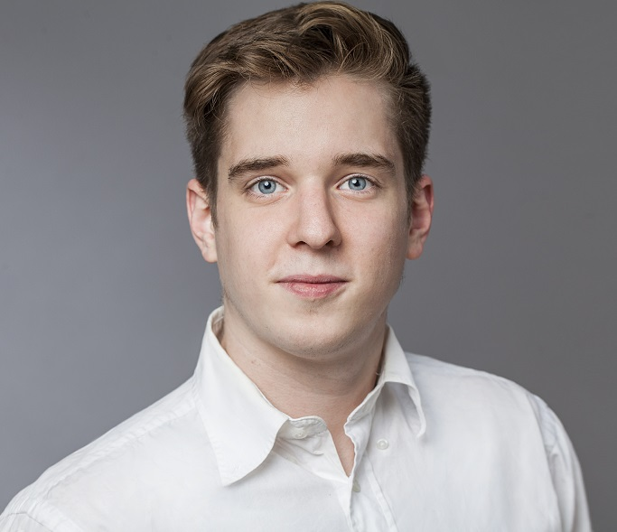
1. Introduction – Oliver Klippel
Person
Education
Today
Name Oliver Klippel
Age 23
From Berlin
Abitur
Vocation IT specialist for systemintegration
Company Deutsche Telekom AG
Business Unit Business Applications & Cloud Services
Apprenticeship until 2018
1 semester computer science & 1 semester media computer science
Introduction
TelekomCLOUD + OpenStack
Q & A

Slide 6
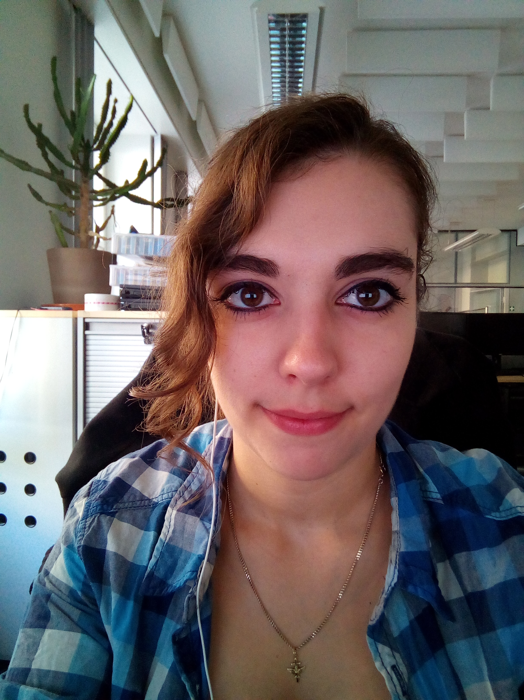
1. Introduction – Janika Schäfer
Person
Education
Today
Name Janika Schäfer
Age 21
From Berlin
Apprenticeship to IT systems technician
studying bachelor of engineering in communication & media computer science
Company Deutsche Telekom AG
Business Unit Business Applications & Cloud Services
finished 2015
with Abitur
Introduction
TelekomCLOUD + OpenStack
Q & A

Slide 7
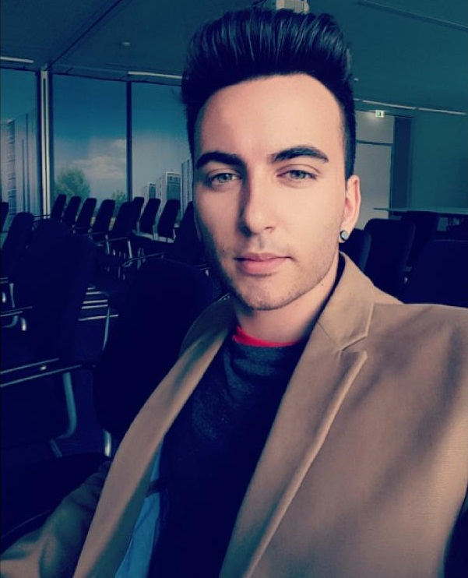
1. Introduction – Adriano Perri
Person
Education
Today
Name Adriano Perri
Age 23
From Berlin
Abitur
studied 2 semester geoecology
Apprenticeship until 2018
Vocation management assistant in IT systems
Company Deutsche Telekom AG
Business Unit Business Applications & Cloud Services
Introduction
TelekomCLOUD + OpenStack
Q & A

Slide 8
1.1 Workflow
4
Create Refcard
writing down (structured)
comply with the corporate design
use supporting illustrations
3
Documentation
gather information unfiltered
screen information
organize them
2
Conception
what is important ?
what is asked for ?
time management
1
Get an Overview
understand the task/topic
clear up questions
get inspired by other refcards
Introduction
TelekomCLOUD + OpenStack
Q & A

Slide 9

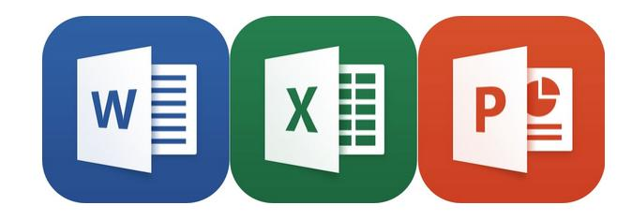


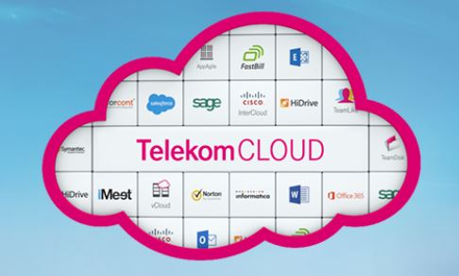

1.1 Experiences
Ehh What?! Ahh! That‘s how it works !
self-management
tools to use
find solutions
discover talents
Introduction
TelekomCLOUD + OpenStack
Q & A

Slide 10
2. TelekomCLOUD + OpenStack

Slide 11
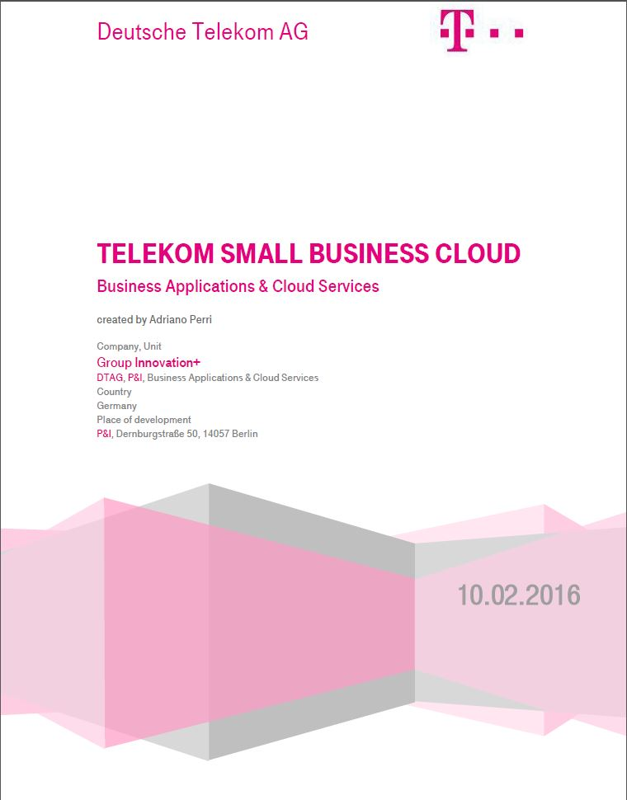
2.1 Refcard – Overview
Introduction
DevOps
General Informations (Tasks/Goals)
OpenStack
What is it?
Which Features?
TelekomCLOUD
New Environment
What we provide
How to start?
Partner & User Integration
Picture: Refcard Telekom SMB Cloud
Introduction
TelekomCLOUD + OpenStack
Q & A

Slide 12
2.2 Our Deployment – Services We Use
Service Name | Function
Nova (Compute) | Virtual Machine Management
Neutron (Networking) | Network Management
Cinder (Block Storage) | Storage Resource Management
Keystone (Identity Service) | Identity Management
Glance (Image Service) | Image Management
RabbitMQ (Message Oriented Middleware) | Communication Management
Razor (Bare-Metal Provisioning) | Process Of Installing An Operating System
Ceph S3 (Object Storage) | Storage Resource Management
Introduction
TelekomCLOUD + OpenStack
Q & A

Slide 13

2.2 Our Deployment – Datacenter
brand new datacenter Biere near Magdeburg
largest cloud datacenter in germany
40.000 m² area
high security through complex security systems
12 emergency power generators
high availability
we give the resources you need !
Introduction
TelekomCLOUD + OpenStack
Q & A

Slide 14

Thank you for your Attention !!

Slide 15
Sources
Informations
https://dzone.com/refcardz/getting-started-openstack-most
Pictures
http://www.ofekcloud.com/media/images/1e7b5ca3-8b2e-4e2e-9898-5df978f0218aimage14.jpeg ( Slide #9 CC)
http://www.all-stars.de/blog/wp-content/uploads/2014/04/planung.jpg (Slide #9 Planning)
http://www.maclife.de/ratgeber/microsoft-office-ios-jetzt-icloud-unterstuetzung-10062588.html (Slide #9 Office Tools)
http://yourdost.com/blog/2016/02/how-to-become-more-creative.html (Slide #9 Creative)
http://www.embritas.lt/project/duomenu-apdorojimo-centras/?lang=de (Slide #13 Datacenter Biere)
https://www.openstack.org/brand/openstack-logo/logo-download/ (Slide #1,#9 OpenStack Logo)
http://cloud-computing-blog.eu/was-ist-jetzt-eigentlich-cloud-computing/
https://www.openstack.org/
Other Sources : AiolosSystemDescription.pdf; Telekom Small Business Cloud_Refcard for ISVs.pdf
https://de.pinterest.com/pin/556053885218068326/ (Slide #15 Background)
http://webneel.com/daily/creative-drawing-jennifer-tjorvi (Slide #9 Talents)
Introduction
TelekomCLOUD + OpenStack
Q & A

Slide 16
3. Questions & Answers

